Slide 1
Electricity Bill & Energy Consumption Analysis Using Excel
Analyzing energy usage and costs with Excel tools
Notes:
Good morning/afternoon everyone.
My Name is Rudrashis Chowdhury,
Today, I will present our Excel project titled “Electricity Bill & Energy Consumption Analysis.”
This project was developed using Microsoft Excel to analyze electricity consumption data, identify energy usage patterns, and create an interactive dashboard for reporting and decision-making.
Throughout this presentation, I will explain the project's objectives, dataset, Excel techniques, dashboard design, key insights, and learning outcomes. The project demonstrates how Excel can be used as a powerful analytical and business intelligence tool.

Slide 2
Electricity Bill & Energy Consumption Analysis
Notes:
This project focuses on analysing electricity bills and energy consumption records using Excel-based analytical techniques.
The primary goal was to convert raw electricity data into meaningful business insights through data cleaning, transformation, visualization, and dashboard development.
The project simulates a real-world business scenario where organizations need to monitor energy costs, identify high-consumption areas, and take corrective action to improve efficiency.

Slide 3
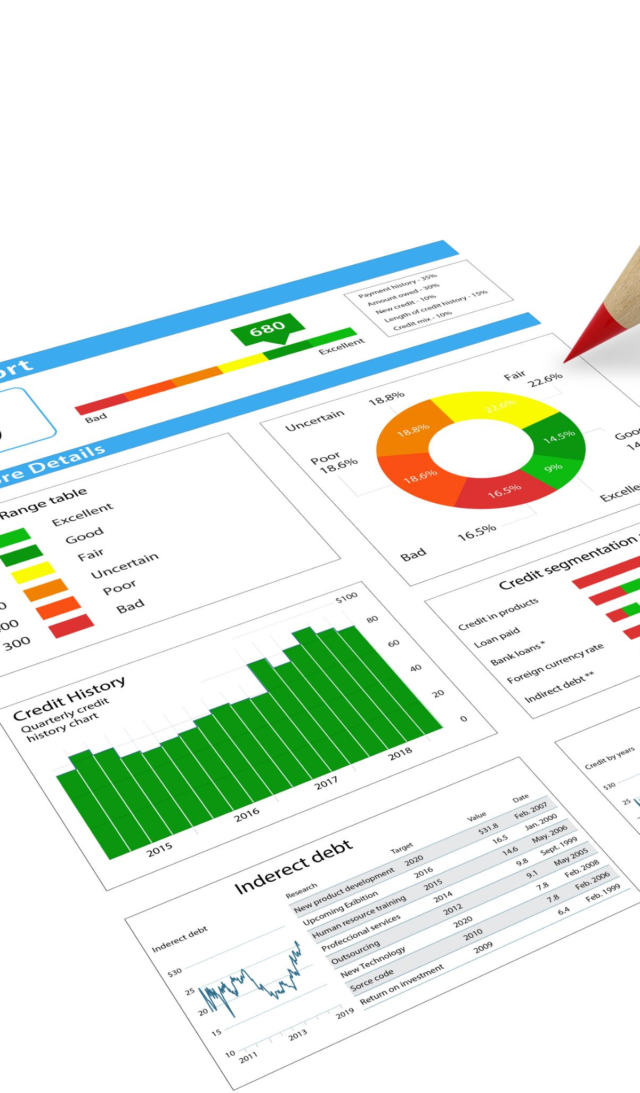
Project Title and Introduction
Project Overview
The project analyzes electricity consumption and billing data using Microsoft Excel to generate practical insights.
Data Dimensions
Analysis covers monthly trends, city-wise comparisons, appliance-level usage, and billing impact.
Analytical Approach
The project emphasizes data cleaning, transformation, and interactive dashboard development for insights.
Learning Outcomes
Demonstrates Excel's capability as an analytical platform supporting data-driven decision-making in energy management.
Notes:
The project analyses electricity consumption and billing data to understand energy usage behavior.
The analysis covers:
Monthly consumption trends
City-wise comparisons
Appliance-level consumption
Billing impact on overall costs
The project demonstrates the complete analytics lifecycle, beginning with raw data and ending with executive-level dashboards.
It also highlights Excel's ability to support data-driven decision-making through interactive reporting and visualization.

Slide 4
Project Overview
Notes:
In this section, I will discuss the project's objectives and scope.
The main objective was to develop an analytical dashboard capable of monitoring electricity consumption and billing data.
The project focuses on:
Data preparation
Trend analysis
KPI calculation
Interactive dashboard creation
Ultimately, the goal is to help users understand consumption behaviour and identify opportunities for reducing electricity costs.

Slide 5
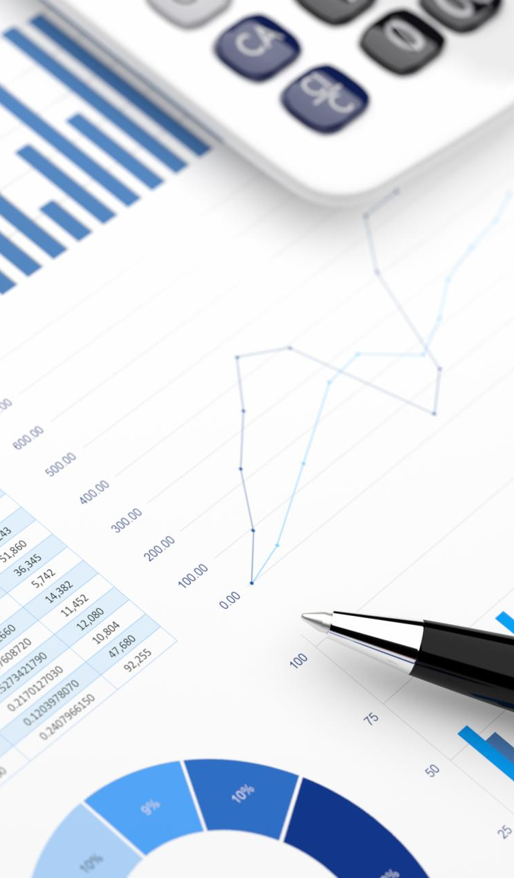
Objectives and Scope of the Project
Data Cleaning and Preparation
Ensuring data accuracy and consistency by cleaning and organizing raw electricity consumption datasets before analysis.
Consumption Analysis
Analyzing energy usage patterns over time, by city, and by appliance type to identify trends and high-usage areas.
Interactive Dashboard
Building a dashboard with filters and slicers for dynamic exploration of key electricity consumption metrics.
Cost Drivers and Trends
Identifying monthly consumption trends, high-consumption periods, and factors affecting electricity bills for optimization.
Notes:
There were four major objectives of this project.
First, we cleaned and organized the raw dataset to improve data quality.
Second, we analysed usage patterns across months, cities, and appliances.
Third, we created an interactive dashboard using Pivot Tables, Charts, and Slicers.
Finally, we identified cost drivers and consumption trends that influence electricity bills.
The scope covers the entire Excel analytics process, from data preparation to business reporting and visualization.

Slide 6
Dataset Description
Notes:
The dataset consists of electricity consumption and billing information collected across multiple observations.
Key data fields include:
Monthly energy usage
Electricity bills
Appliance consumption
Operating hours
City information
Because the dataset contains several dimensions of data, it supports detailed analysis across time, location, and appliance categories.

Slide 7

Understanding the Data Used
Dataset Composition
The dataset includes monthly energy use, billing, appliance consumption, operating hours, and city-wise data.
Data Structure and Analysis
The dataset supports vertical and horizontal analysis across time, location, and appliances for detailed insights.
Data Quality Challenges
Raw data contains missing values, formatting issues, and redundancies that must be addressed for accurate analysis.
Foundation for KPIs
Understanding the data ensures accurate KPI development and meaningful consumption behavior insights within Excel.
Notes:
Before performing analysis, it was important to understand the dataset structure.
The data contained information that could be analysed both horizontally and vertically.
Like many real-world datasets, it included:
Missing values
Formatting inconsistencies
Duplicate records
Understanding the dataset helped us build reliable KPIs and ensure meaningful analytical results throughout the project.

Slide 8
Data Cleaning and Preparation
Notes:
Data cleaning was one of the most important phases of the project.
We performed several activities including:
Removing duplicate records
Correcting formatting issues
Handling missing values
Verifying data accuracy
A clean dataset is essential because inaccurate data leads to unreliable analysis and poor business decisions. This step prepared the foundation for all subsequent calculations and dashboard development.

Slide 9
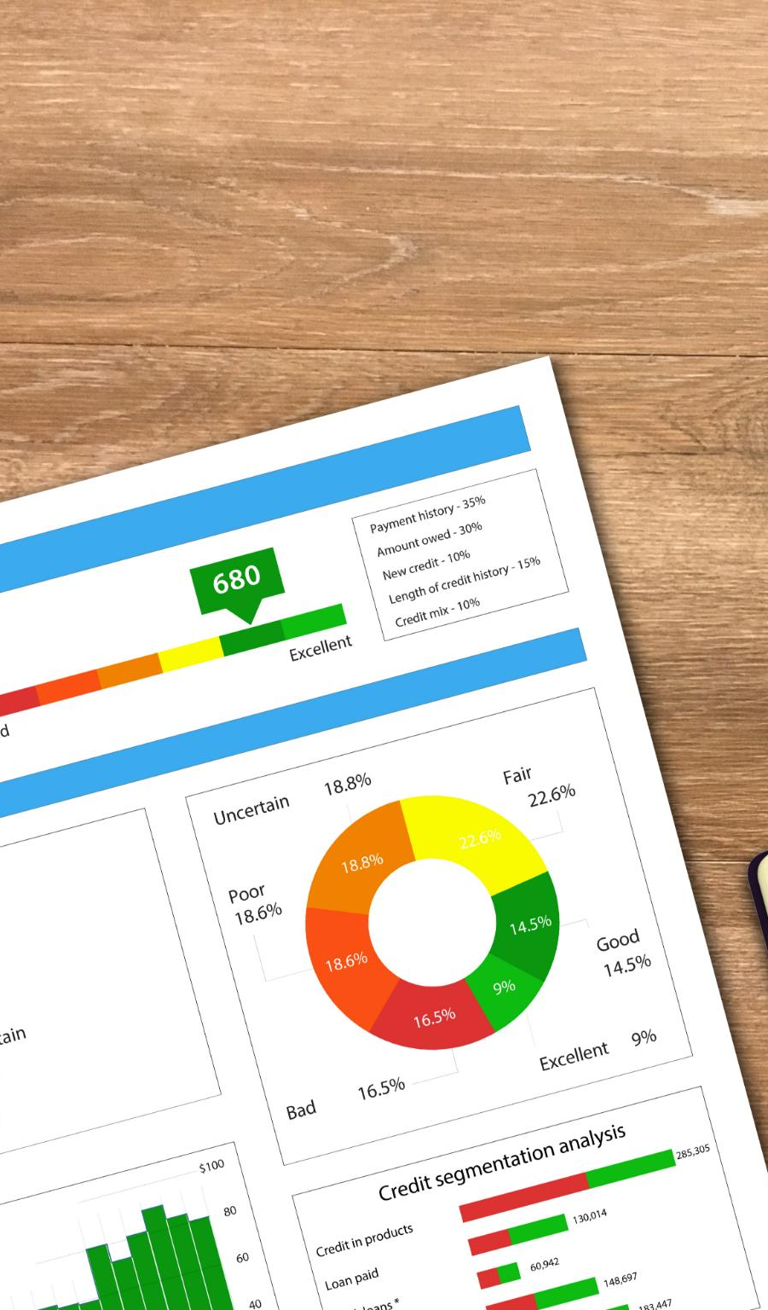
Preparing Analysis-Ready Data
Removing Duplicate Records
Eliminating duplicate entries ensures consumption values are accurate and not overstated in analysis.
Standardizing Data Formats
Consistent date, number, and categorical formats enable reliable analysis with Pivot Tables and formulas.
Handling Missing Values
Using Excel functions like IF and IFERROR stabilizes calculations by addressing missing data effectively.
Ensuring Data Accuracy
Verification and alignment of billing and consumption data maintain data integrity for analysis.
Notes:
To make the data ready for analysis, we standardized dates, numbers, and categorical fields.
Excel functions such as:
IF
IFERROR
Lookup Functions
were used to address data quality issues.
After validation and transformation, the dataset became suitable for Pivot Tables, KPI calculations, charts, and dashboard reporting.

Slide 10
Excel Tools and Techniques
Notes:
This project utilizes several advanced Excel features.
The most important tools included:
Pivot Tables
Pivot Charts
Slicers
Conditional Formatting
Advanced Excel Functions
These features helped summarize large volumes of data and transform them into meaningful visual insights for end users.

Slide 11
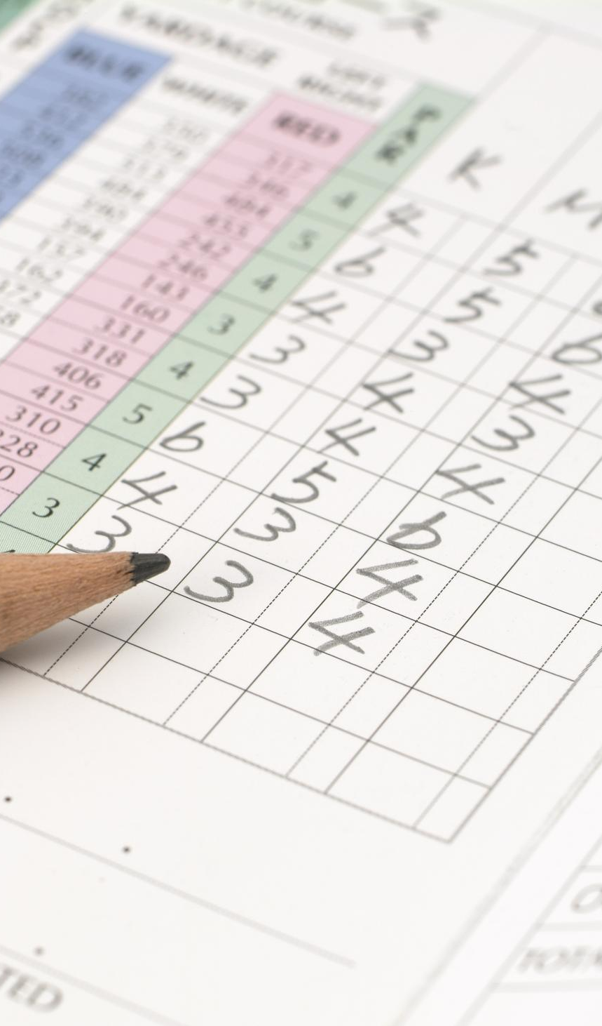
Key Excel Features Used
Pivot Tables for Data Summarization
Pivot Tables summarize large datasets to generate insights across multiple dimensions like time, city, and appliances.
Pivot Charts for Visualization
Pivot Charts visualize summarized data, making patterns and trends easier to interpret in reports.
Interactivity via Slicers and Filters
Slicers and filters allow dynamic data views without altering formulas, enhancing user interactivity.
Conditional Formatting and Functions
Conditional formatting highlights key values, while Excel functions calculate KPIs and handle data exceptions.
Notes:
Pivot Tables were used to aggregate and summarize data efficiently.
Pivot Charts converted numerical summaries into visual representations for easier interpretation.
Slicers provided dashboard interactivity, allowing users to filter results dynamically.
Conditional formatting highlighted important patterns, while functions such as SUMIFS, COUNTIFS, and AVERAGEIFS supported KPI calculations and reporting.

Slide 12
Dashboard Design
Notes:
The dashboard is the central deliverable of this project.
It consolidates all important metrics into a single interface and gives users a high-level overview of electricity consumption and billing performance.
The design emphasizes simplicity, usability, and quick decision-making through visual reporting.

Slide 13

Interactive Excel Dashboard
Key Performance Indicators
KPI cards display total electricity consumption, billing amounts, and average usage for quick insights.
Consumption Trends Visualization
Line and column charts illustrate monthly electricity consumption trends highlighting peak and low usage periods.
City and Appliance Comparisons
City-wise and appliance-wise charts help identify top energy consumers and major contributors.
Interactive Data Exploration
Slicers and filters enable dynamic exploration of data for detailed analysis and reporting.
Notes:
The dashboard contains KPI cards showing:
Total energy consumption
Average usage
Billing information
It also includes charts showing:
Monthly trends
City-wise comparisons
Appliance-wise consumption
Interactive slicers allow users to explore the data from different perspectives without modifying the underlying dataset.

Slide 14
KPI Analysis
Notes:
KPIs are critical because they summarize business performance in a concise and measurable format.
In this project, KPIs were designed to monitor overall energy usage, average consumption, and electricity costs.
These indicators provide a quick snapshot of performance and help identify unusual consumption patterns.

Slide 15

Measuring Performance Indicators
Key KPIs Tracked
Total energy consumption, average monthly usage, and total electricity bill are the main KPIs monitored for performance.
KPI Aggregation Levels
KPIs are aggregated monthly and city-wise to support detailed comparisons and better decision-making.
KPI Dashboard Benefits
Visual KPIs enable users to quickly monitor performance, reducing the need to analyze raw data tables.
Excel for Reporting
Excel is effectively used for performance monitoring and management reporting in energy consumption projects.
Notes:
The project tracks three primary KPIs:
Total Energy Consumption
Average Monthly Consumption
Total Electricity Bill
These metrics can be analysed across months and cities to identify patterns and trends.
Using KPI dashboards reduces the need to review detailed datasets and enables faster decision-making.

Slide 16
Insights and Findings
Notes:
After analysing the data, several valuable insights were discovered.
The analysis identified:
Peak consumption periods
Consumption differences across cities
Appliances responsible for the highest electricity usage
These findings demonstrate the practical value of data analysis for energy management and cost control.

Slide 17
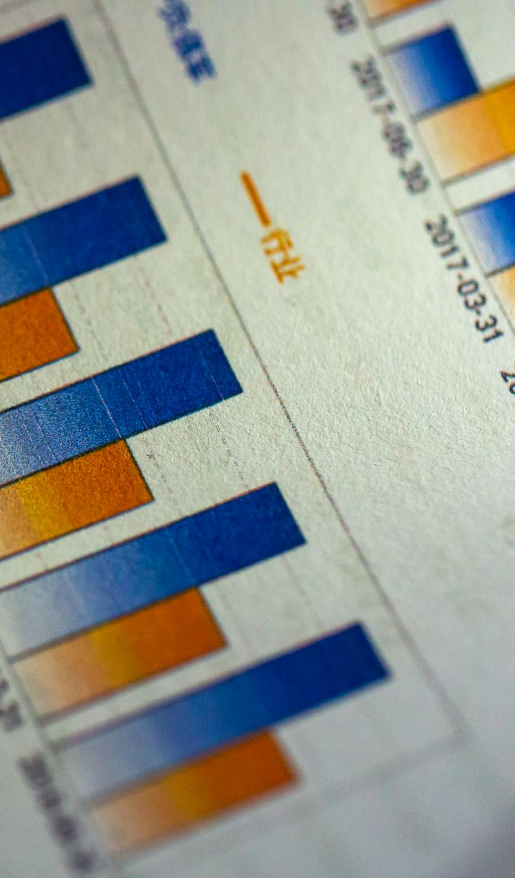
Key Analytical Insights
Monthly Consumption Trends
Monthly analysis identifies peak electricity usage linked to seasonal changes and appliance activity.
City-wise Energy Comparison
Comparing cities reveals variations in energy use, highlighting areas needing efficiency improvements.
Appliance Usage Impact
Analysis pinpoints which appliances contribute most to electricity costs, guiding reduction efforts.
Value of Data Analysis
Structured data analysis transforms raw data into actionable insights for smarter energy management.
Notes:
Monthly consumption analysis revealed seasonal variations and high-demand periods.
City-wise analysis highlighted locations with higher electricity usage patterns.
Appliance-level analysis identified devices that contributed significantly to total consumption and electricity costs.
These insights can help users develop strategies for reducing energy expenses and improving efficiency.

Slide 18
Business Impact and Recommendations
Notes:
The project findings can support both operational and financial decision-making.
By using analytical insights, organizations can improve energy efficiency and better manage electricity expenses.
This demonstrates how Excel analytics can create measurable business value beyond basic reporting.

Slide 19

Practical Recommendations
Reduce Electricity Costs
Monitor high-consumption appliances and optimize their usage during off-peak hours to lower electricity expenses.
Support Infrastructure Planning
City-level energy analysis helps guide infrastructure development and targeted energy-efficiency programs.
Excel Automation Enhancements
Integrate Power Query, use Power Pivot, and apply VBA to automate data loading and advanced modeling tasks.
Notes:
Based on the analysis, several recommendations were developed.
These include:
Monitoring high-consumption appliances
Shifting usage away from peak periods
Implementing energy-saving practices
Future improvements include integrating:
Power Query
Power Pivot
VBA Automation
These enhancements would improve scalability and automation of the analytical process.

Slide 20
Learning Outcomes and Conclusion
Notes:
This project provided significant practical experience in Excel-based analytics.
We gained hands-on exposure to:
Data Cleaning
Data Analysis
Dashboard Design
KPI Development
Data Visualization
The project demonstrates how Excel can be used as a complete business analytics solution.

Slide 21
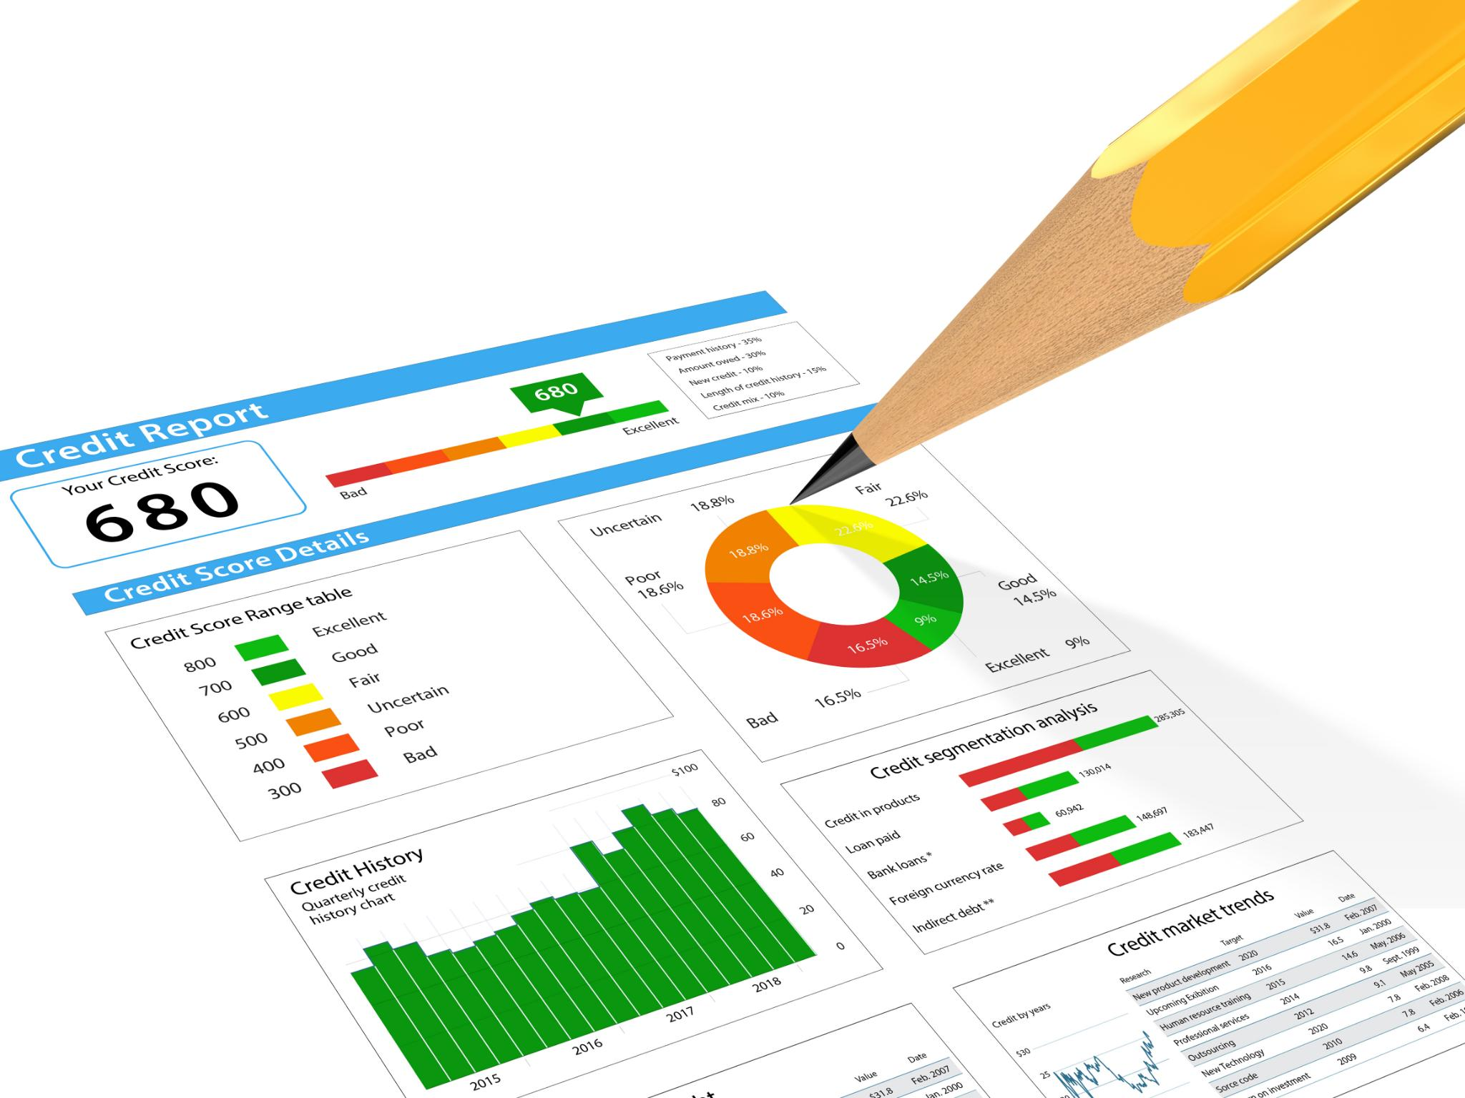
Skills Gained and Final Summary
Excel Data Analysis Skills
Developed essential Excel skills including data cleaning, Pivot Table analysis, and KPI creation for effective reporting.
Dashboard Design and Visualization
Learned to design interactive dashboards and use data visualization to present insights clearly and effectively.
Analytical Thinking and Problem Solving
Enhanced analytical thinking and problem-solving through structured interpretation of real-world electricity consumption data.
End-to-End Data-Driven Analysis
Demonstrated how to transform raw electricity data into actionable insights using Excel for data-driven decision making.
Notes:
To conclude, this project successfully transformed raw electricity consumption data into actionable business insights.
The project strengthened our technical Excel skills while also improving analytical thinking and problem-solving abilities.
Most importantly, it showed how Excel dashboards, KPIs, Pivot Tables, and visualizations can support data-driven decision-making in energy management.
Thank you for your time. I would be happy to answer any questions.

